Slide 1
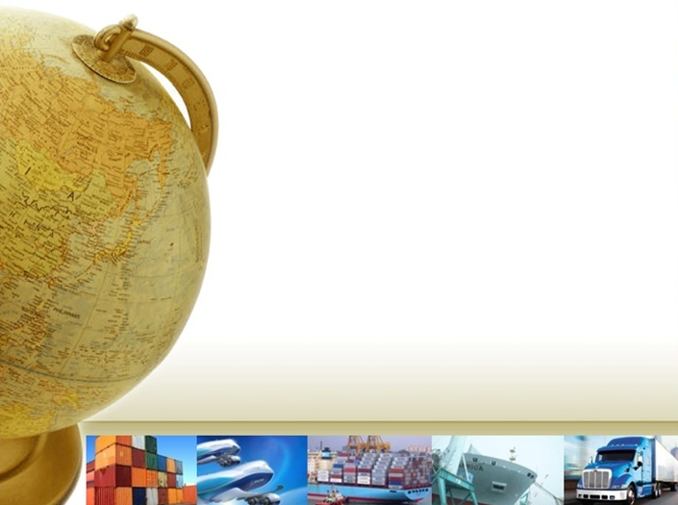

Preliminary Report on Paraguayan Foreign Trade
2017 vs. 2018

Slide 2
Balance of Goods
In thousands of dollars FOB
Note: 1) The item re-export is the difference between the imported goods subject to re-export less total consumption respective potential
2) The item Other includes the following items of the goods account of the balance of payments: electricity, repair of goods, goods for processing and goods procured in ports by carriers, among others.
3) The goods, which compiles the total foreign trade of Paraguay (including the statistics of the National Customs and other items mentioned) is disclosed quarterly basis with a lag of six months as the balance of payments and position international investment.
* Figures subject to change

Slide 3
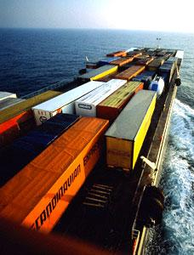
Statistics of Imports

Slide 4
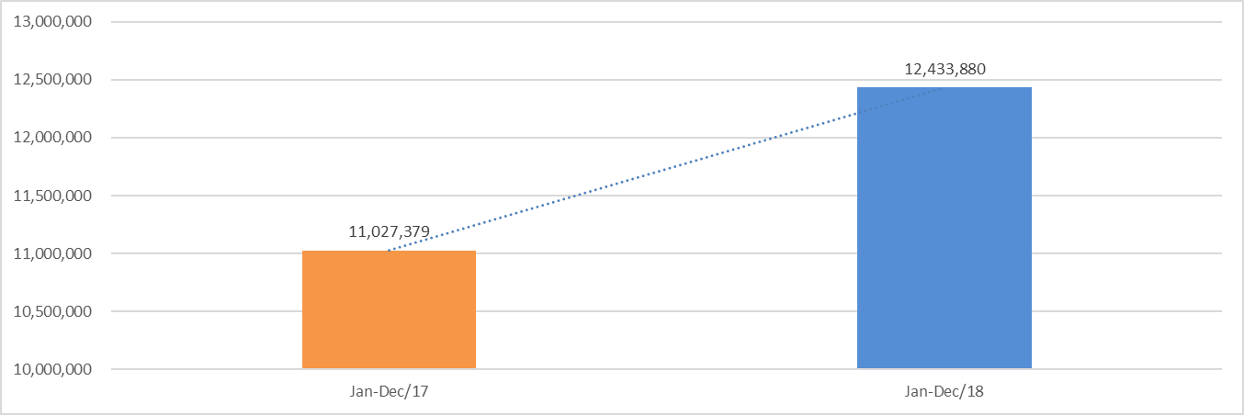
Imports by country from MERCOSUR and Rest of World
(thousand USD FOB)
Notes:
Inserta una fotografía del máximo dirigente de tu país.

Slide 5
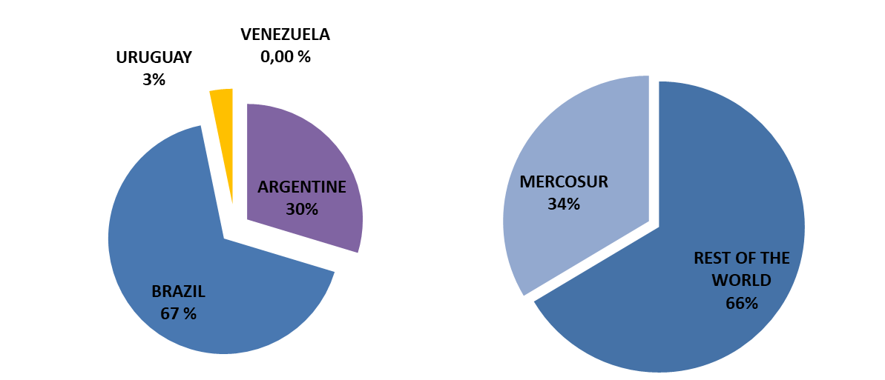
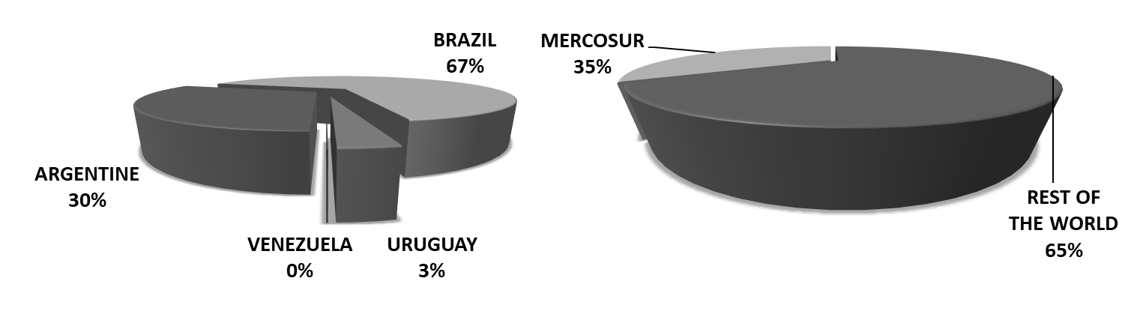
Imports (Grafics)
JANUARY TO DECEMBER
2018
JANUARY TO DECEMBER
2017
PRELIMINARY REPORT ON PARAGUAYAN FOREIGN TRADE - www.cip.org.py
Notes:
Inserta una fotografía del máximo dirigente de tu país.

Slide 6
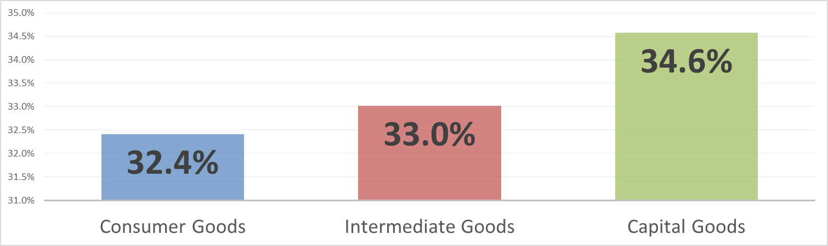
Imports by Type of Goods
(thousand USD FOB)
*Preliminary statistics released by SOFIA (System for the regulation of customs duties) of the D.N.A.
a) Includes paper and cardboard and their by-products, pharmaceuticals, textiles and their by-products, gems and precious metals, other consumer goods and construction material
b) Includes jeeps and pick-up trucks
c) Includes iron and its by-products (except hardware items), non-ferrous metals and their by-products, stones, earths and their by-products, cement and asphalt, other intermediate goods, glass and its by-products
d) Not including automobiles, jeeps and pick-up trucks
e) Includes agricultural equipment and accessories, hardware goods of iron and non-ferrous metals, wood products, and animals
67,6 %
Notes:
Inserta una imagen de uno de los puntos de interés de tu país.

Slide 7
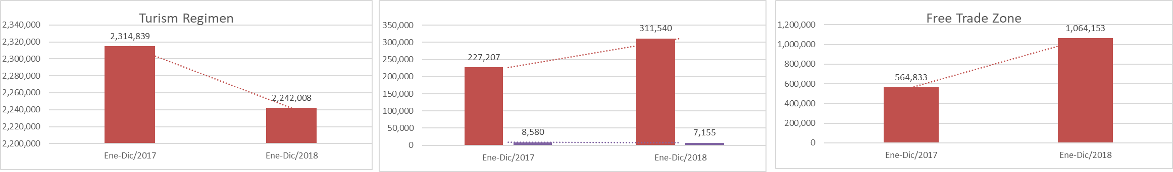
Imports by Customs Regimens
(thousand USD FOB)
Maquila with/without transformation
Notes:
Inserta una imagen de uno de los puntos de interés de tu país.

Slide 8
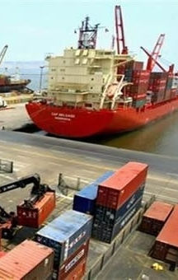
Statistics of Exports

Slide 9
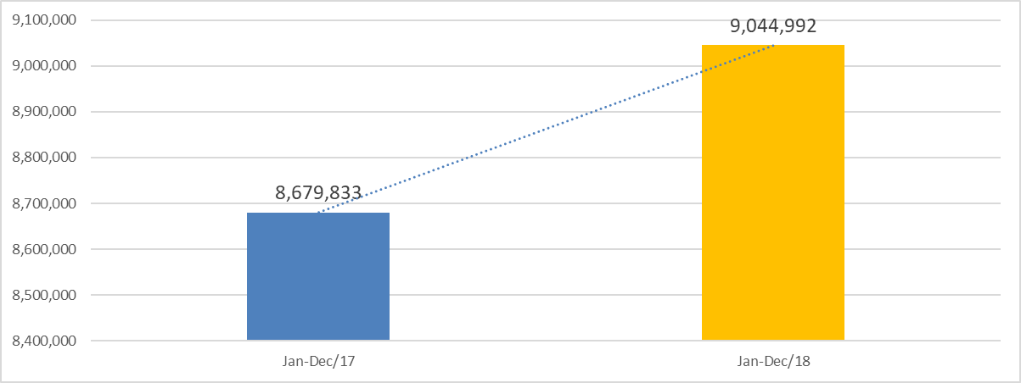
Exports by country from MERCOSUR and Rest of World
(thousand USD FOB)
PRELIMINARY REPORT ON PARAGUAYAN FOREIGN TRADE - www.cip.org.py
Notes:
Inserta una imagen de uno de los puntos de interés de tu país.

Slide 10
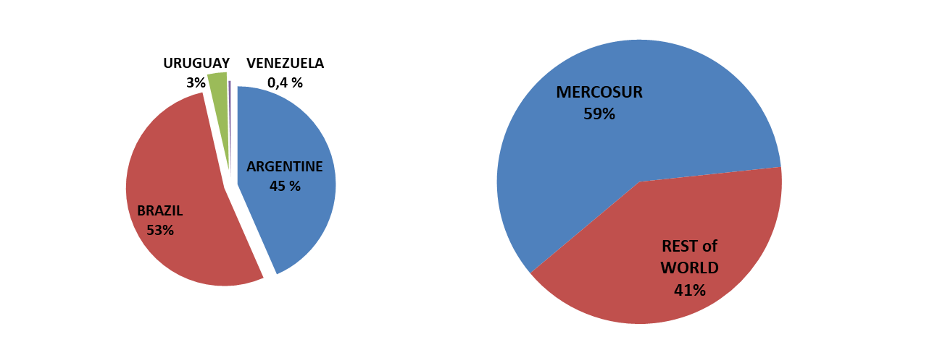
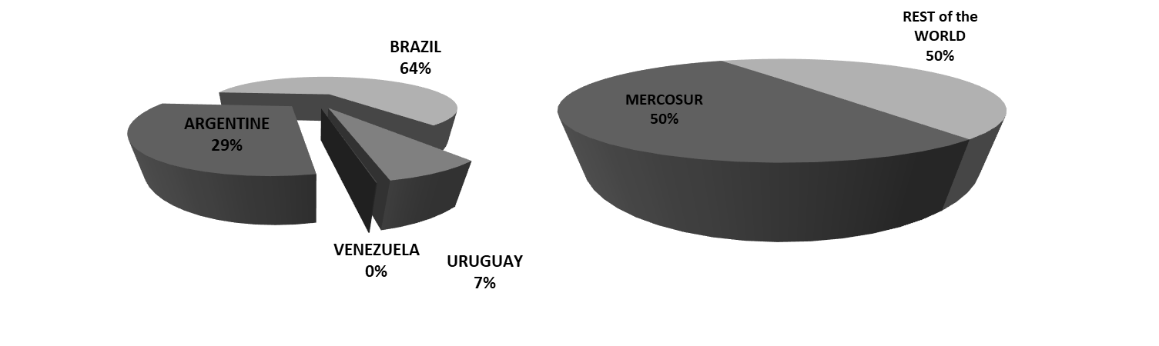
Exports (Grafics)
JANUARY TO DECEMBER
2018
JANUARY TO DECEMBER
2017
PRELIMINARY REPORT ON PARAGUAYAN FOREIGN TRADE - www.cip.org.py
Notes:
Inserta una fotografía del máximo dirigente de tu país.

Slide 11
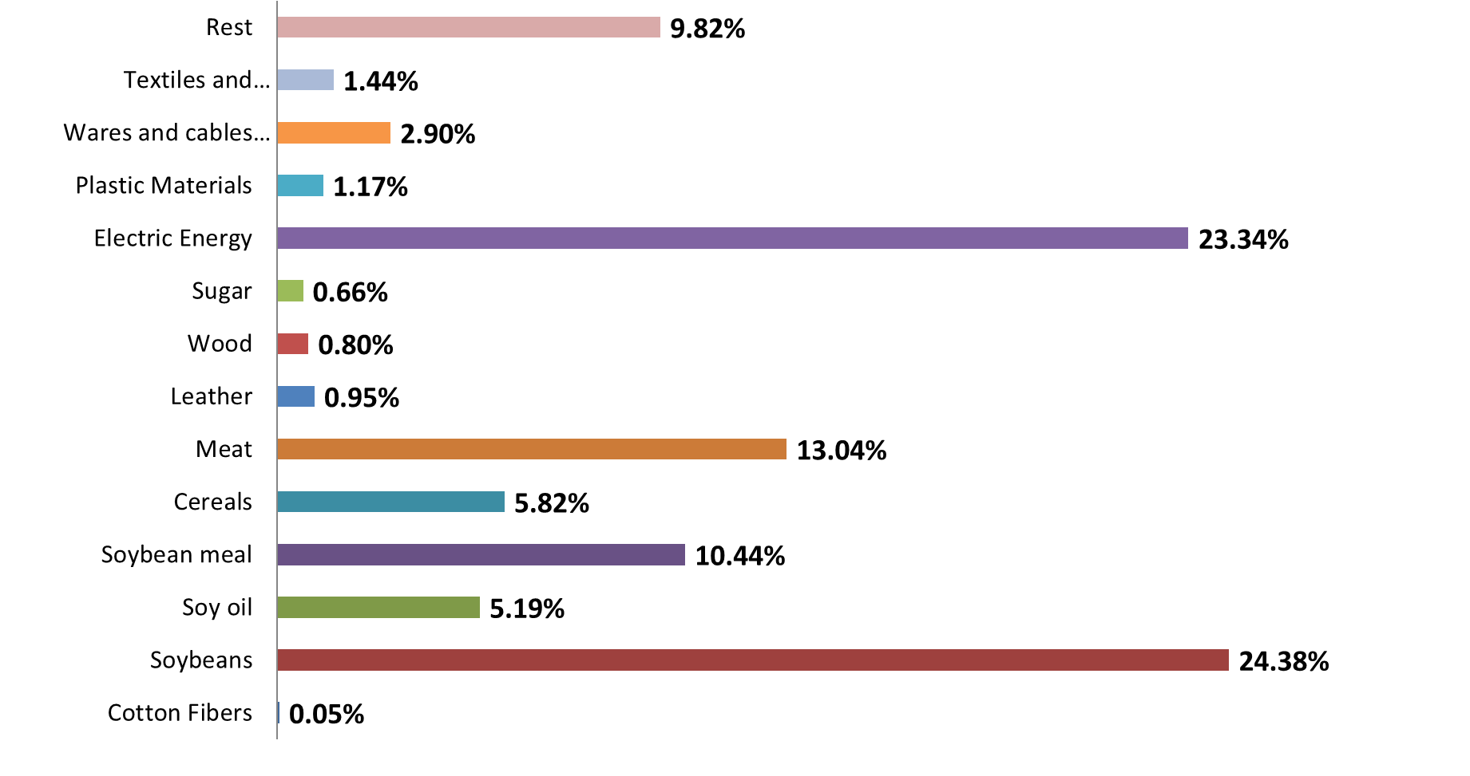
Main Exports Products
(thousand USD FOB)
Notes:
Inserta una imagen de uno de los puntos de interés de tu país.

Slide 12
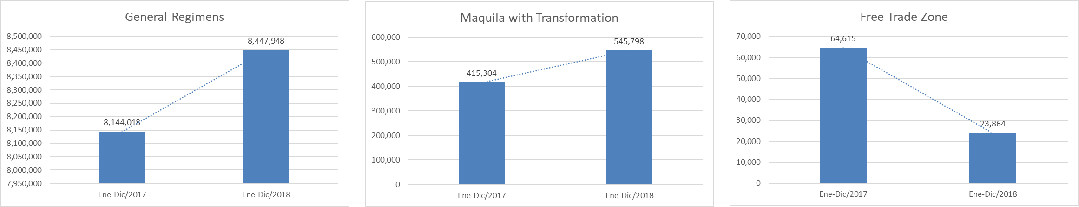
Exports by Customs Regimens
(thousand USD FOB)
Notes:
Inserta una imagen de uno de los puntos de interés de tu país.

